Slide 1

CIrko: a location based SNS Web App
Jiada Ye & DEngke Tang

Slide 2
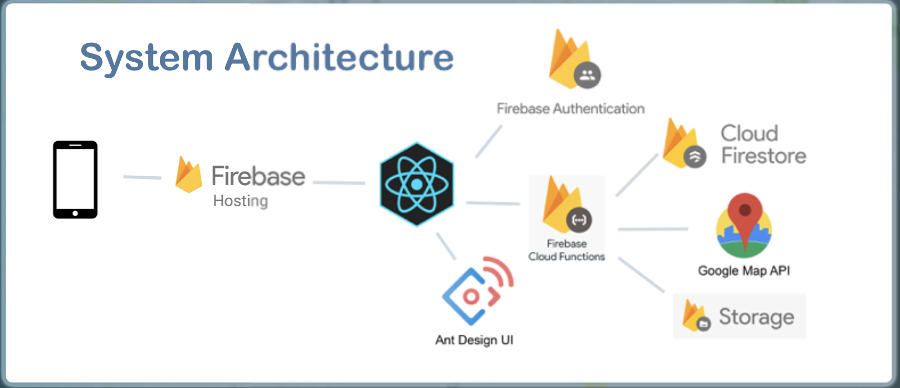

Slide 3




Product Features
CIRKO
View Nearby Posts
Create a Post
Comment
Like a Post

Slide 4
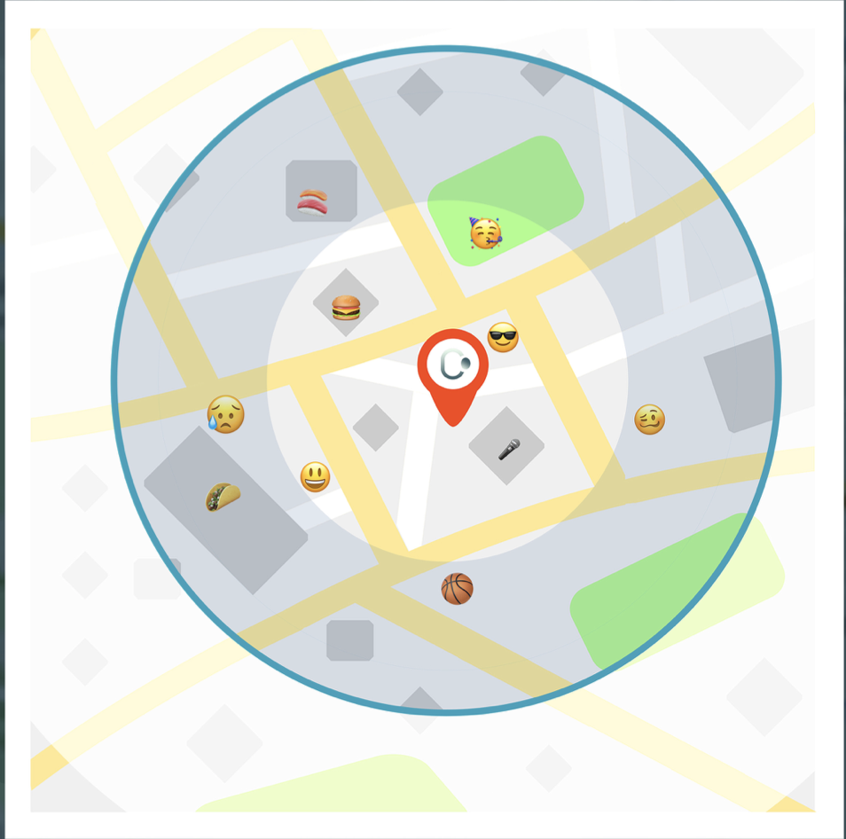
View Nearby Posts
Cirko attaches a location tag to each post and user

Slide 5
View Nearby Posts
Users can use a slider to adjust the radius to filter different ranges of posts

Slide 6
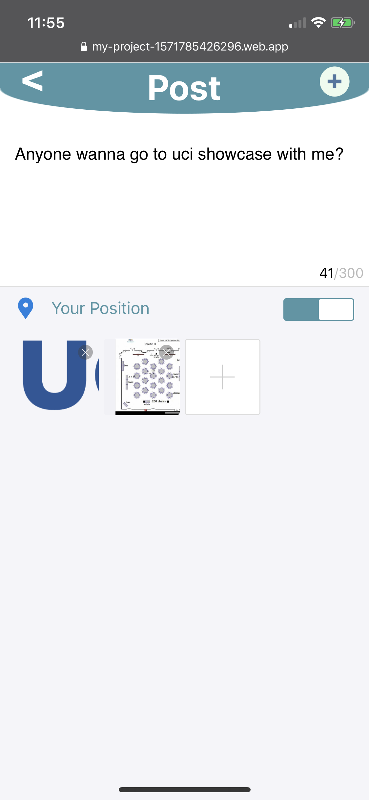
Create a Post
Use 300 letters to convey you feelings.

Slide 7
Create a Post
Use up to 9 photos to show your smile

Slide 8
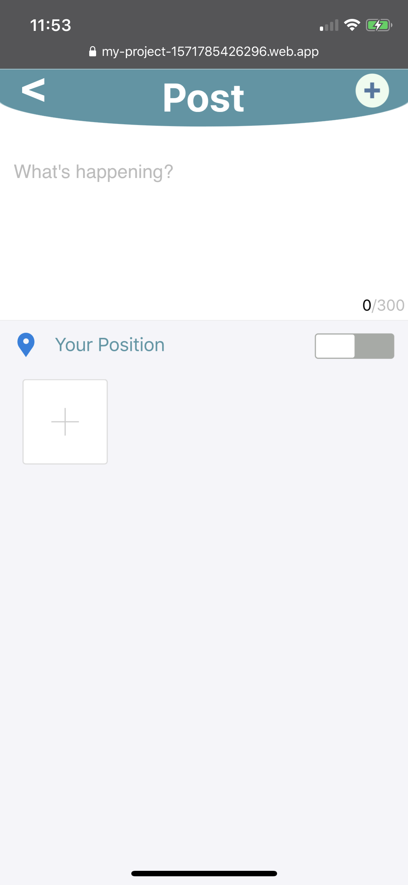
Create a Post
Want anyone else to join?
Show where you are!

Slide 9
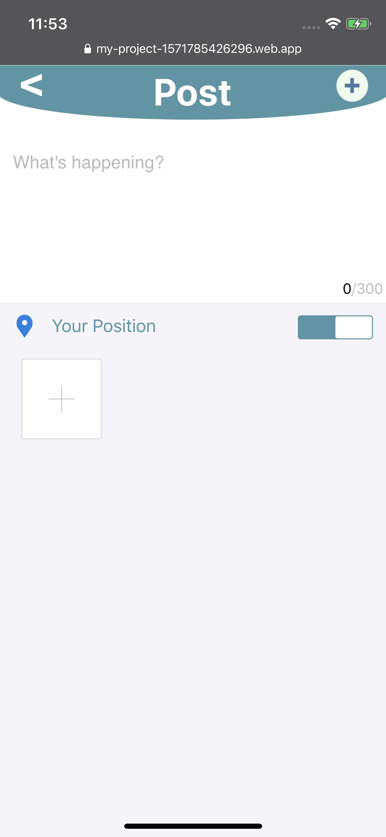
Create a Post
Want anyone else to join?
Show where you are!

Slide 10
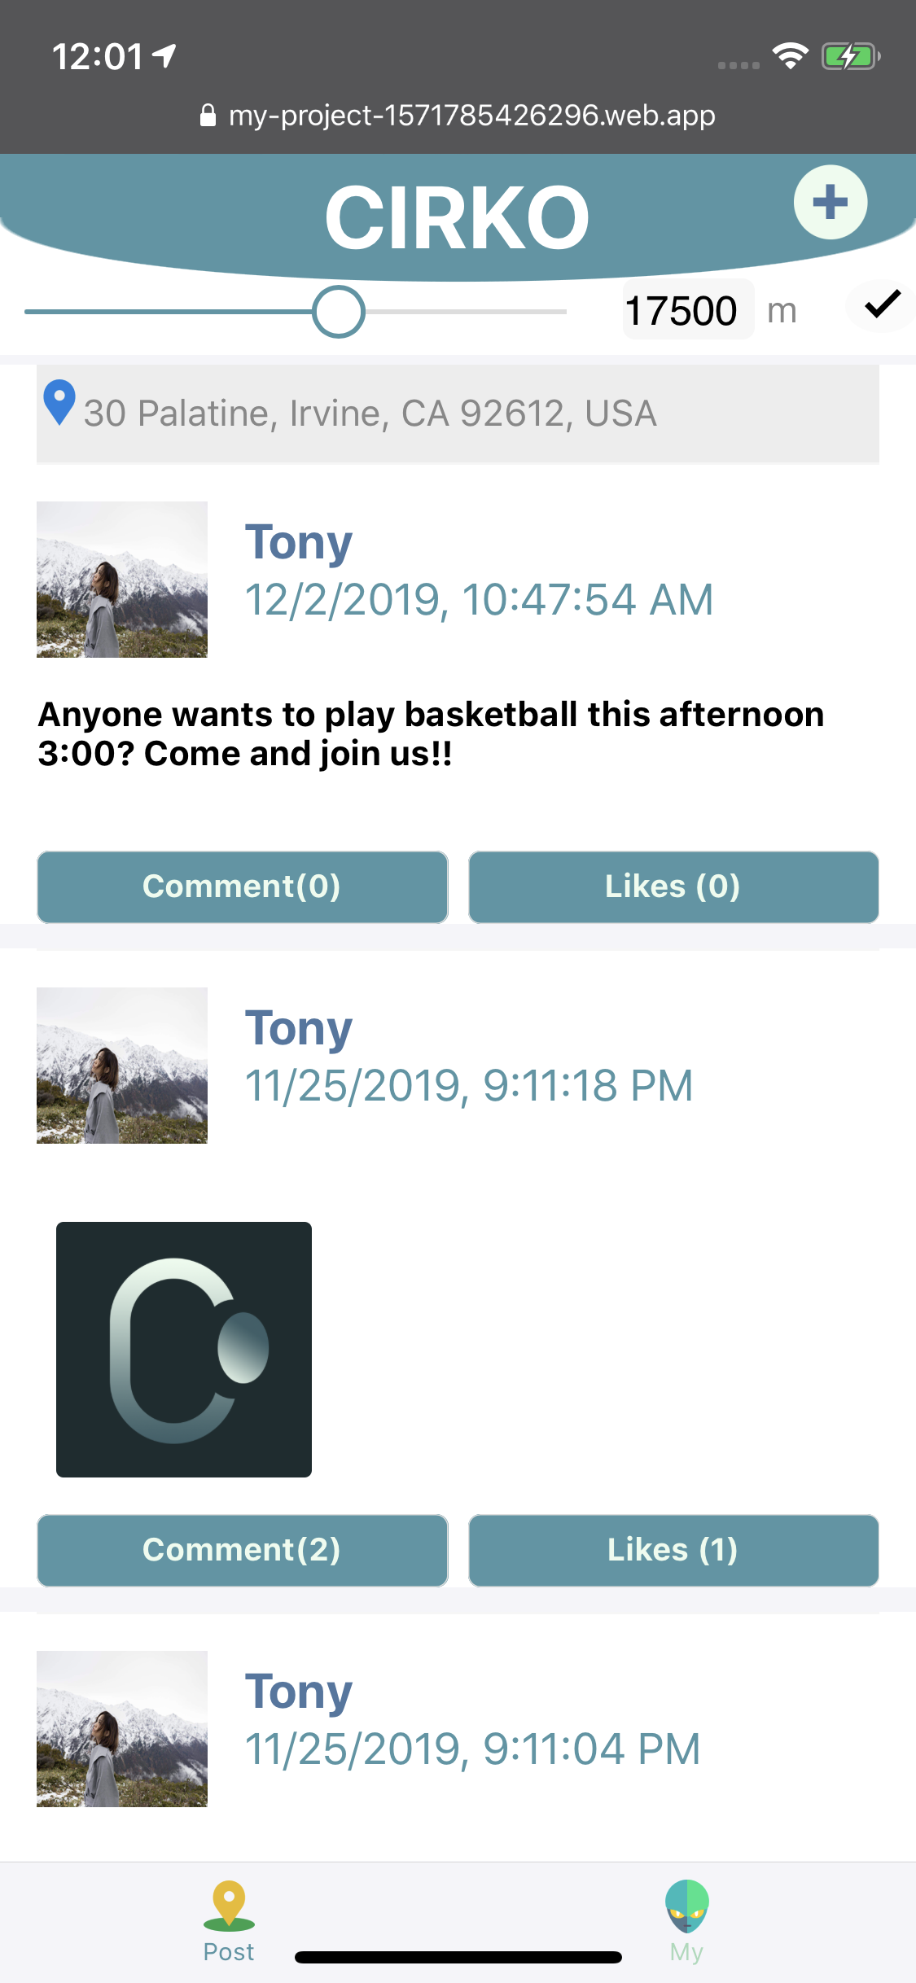
Create a Post
Your location will show above the post

Slide 11
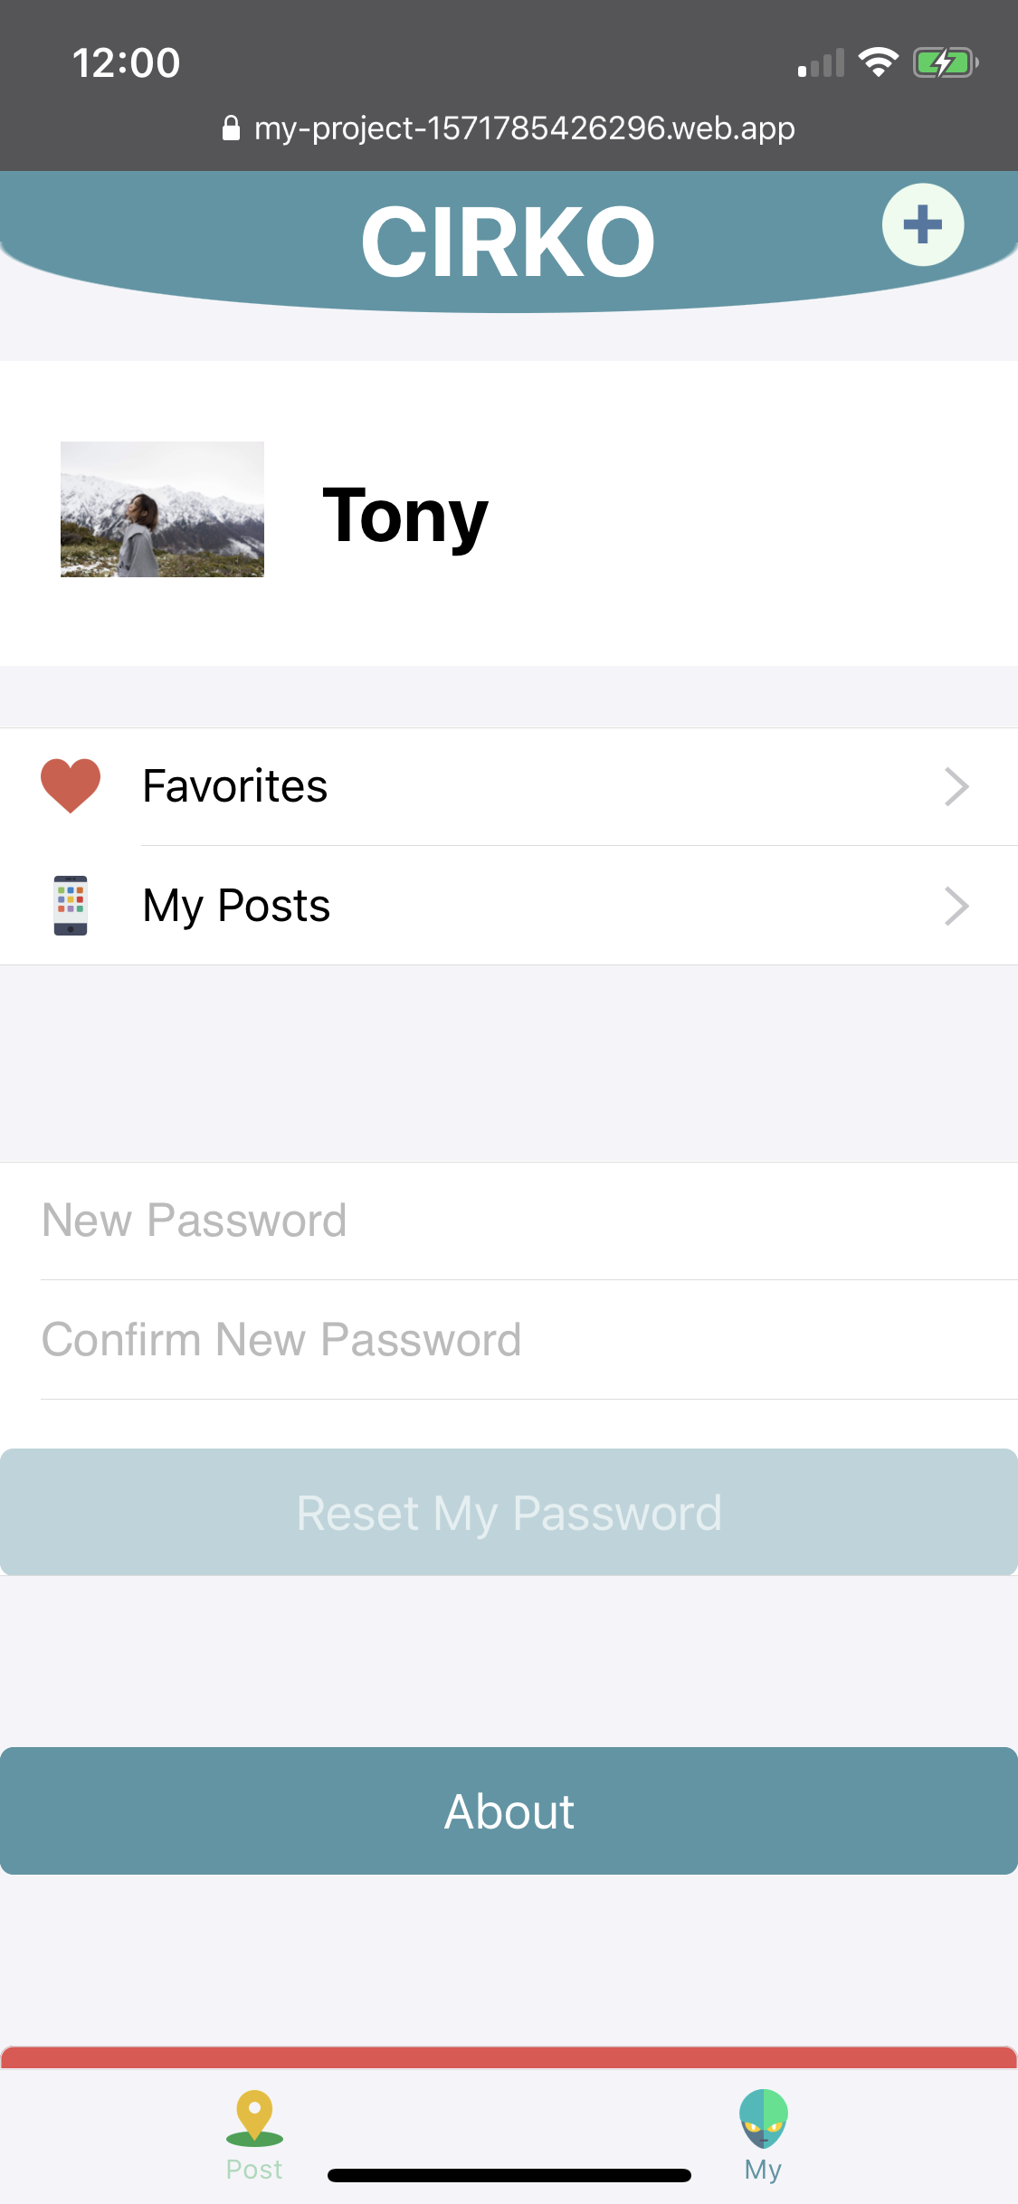
Create a Post
Your can view own post in My Post Page

Slide 12
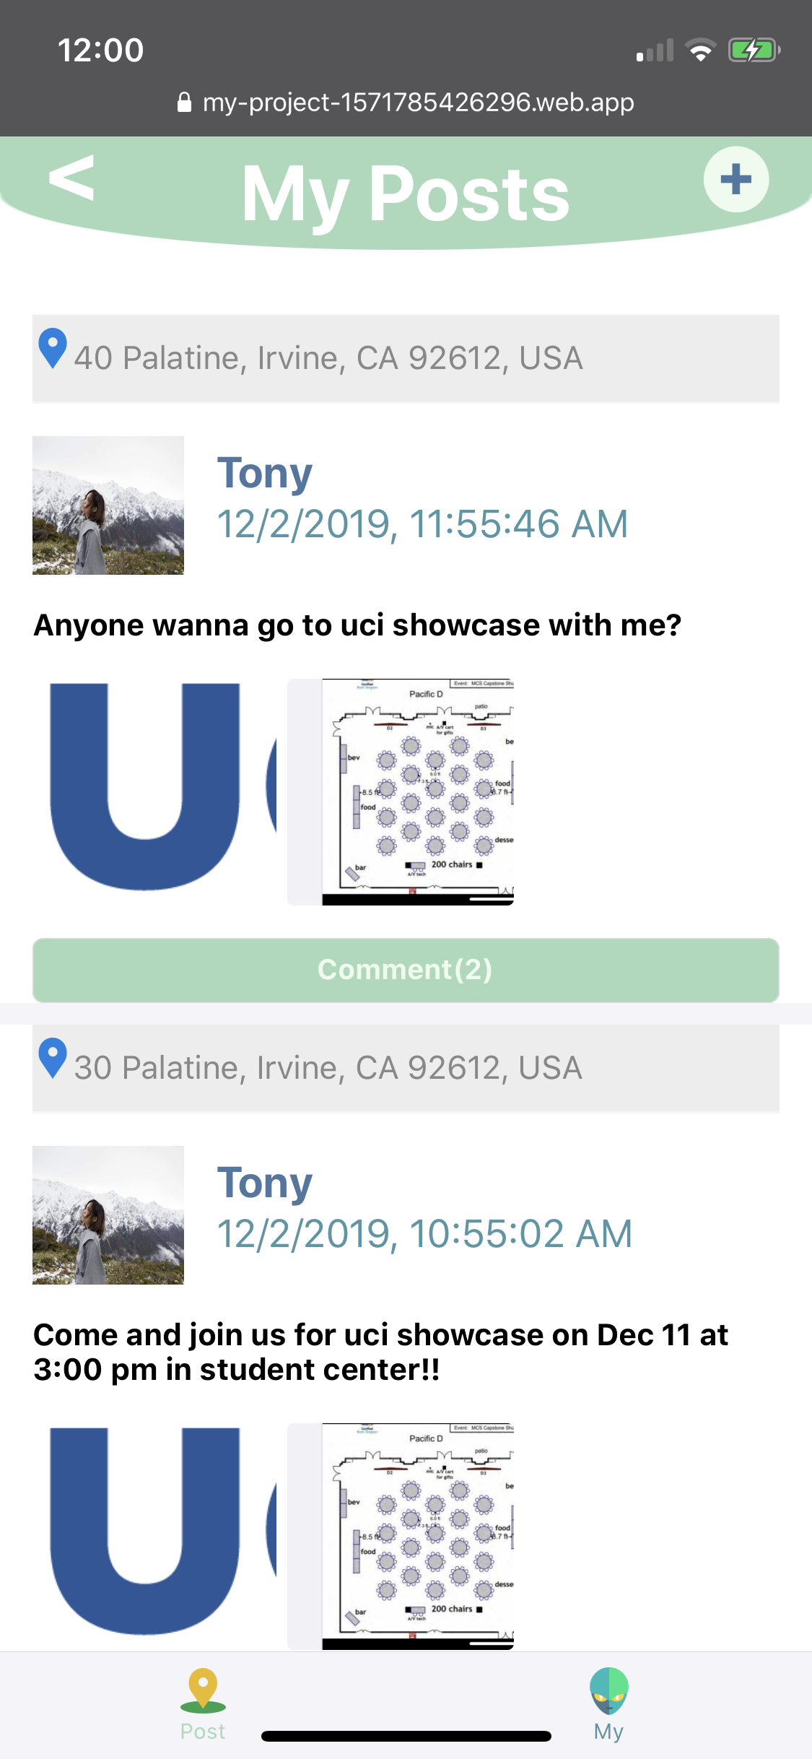
Create a Post
Your can view own post in My Post Page

Slide 13
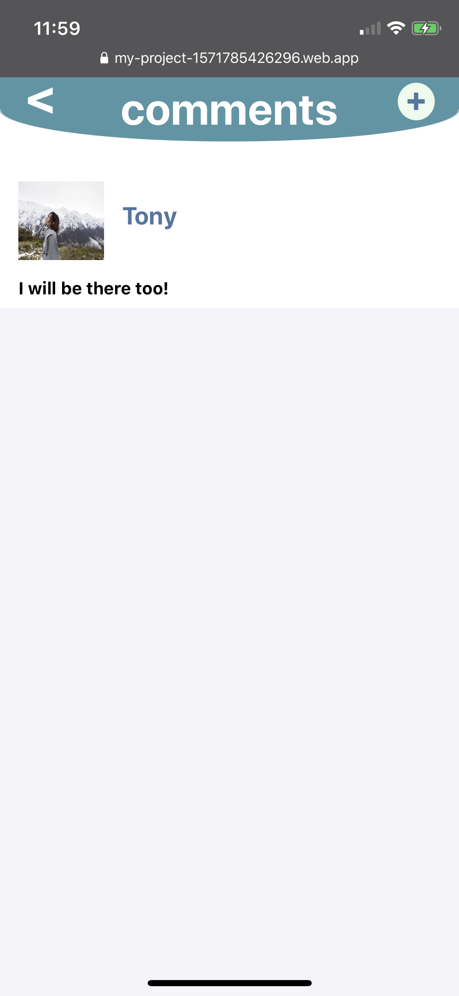
Comments
Share feelings?
Make friends?
Play-dates?
Everything could happen here

Slide 14
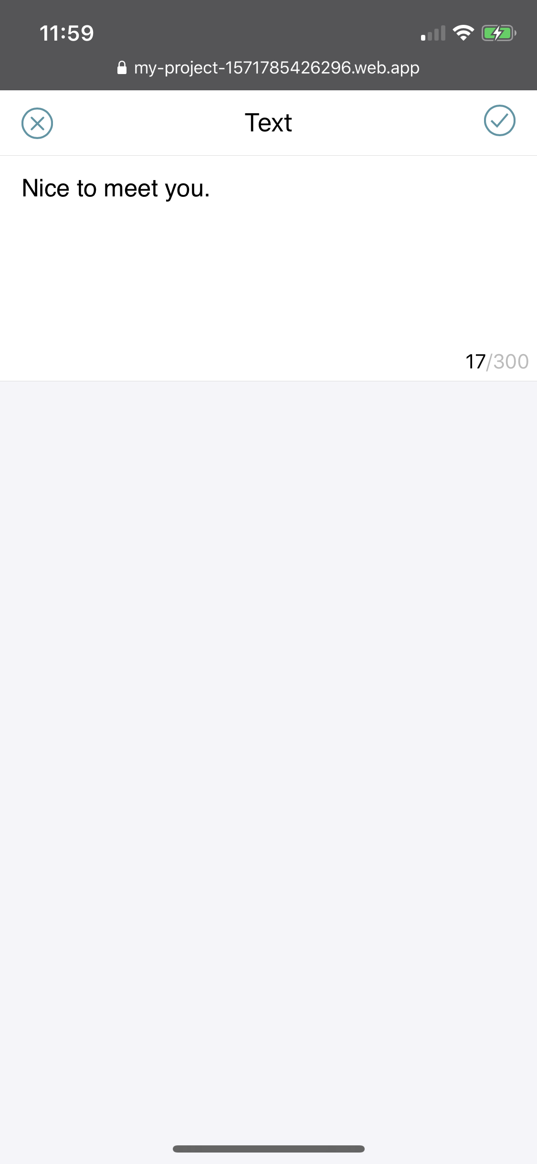
Comments
@Tony
Share feelings?
Make friends?
Play-dates?
Everything could happen here

Slide 15
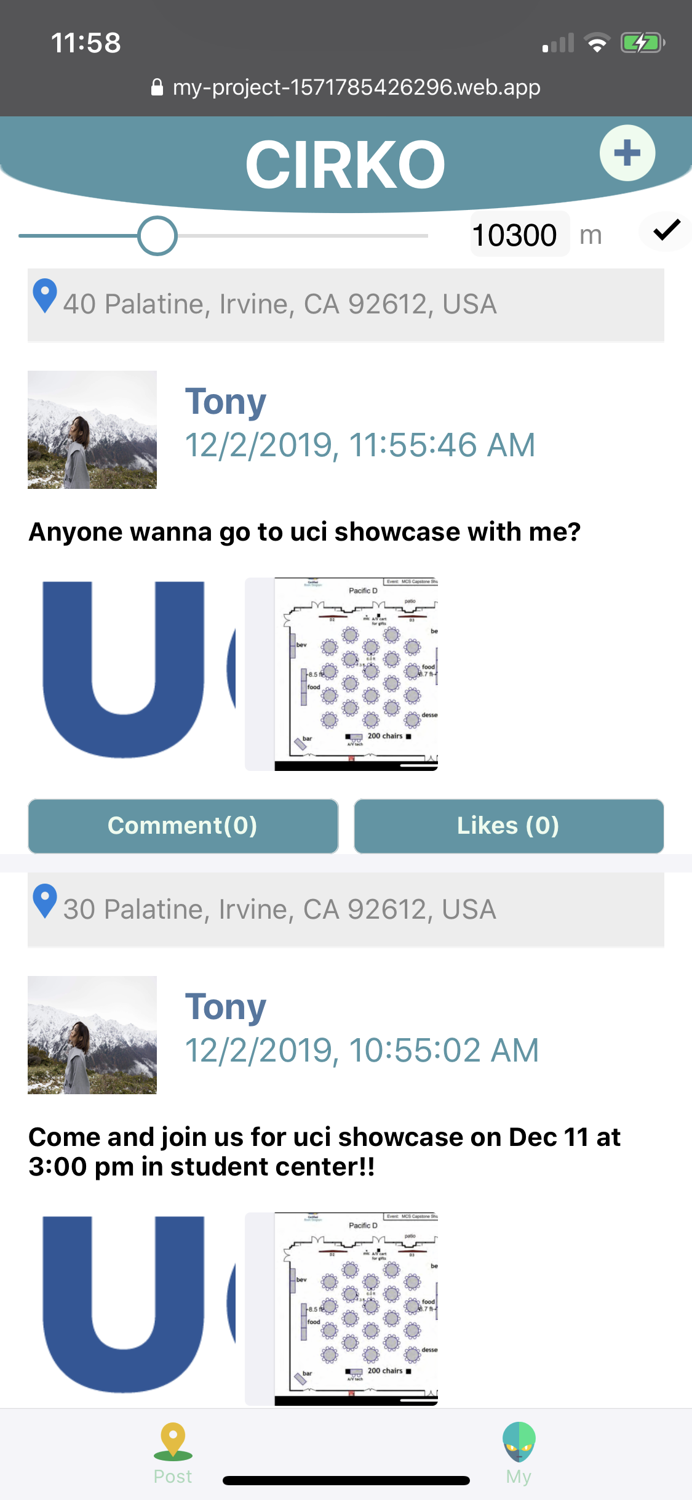
Likes
@Tony
Show your like,
Otherwise it will disappear.

Slide 16

Likes
@Tony
Likes are accumulated and shown on the post.

Slide 17
Likes
@Tony
You can view all you like in
Favorite Page

Slide 18
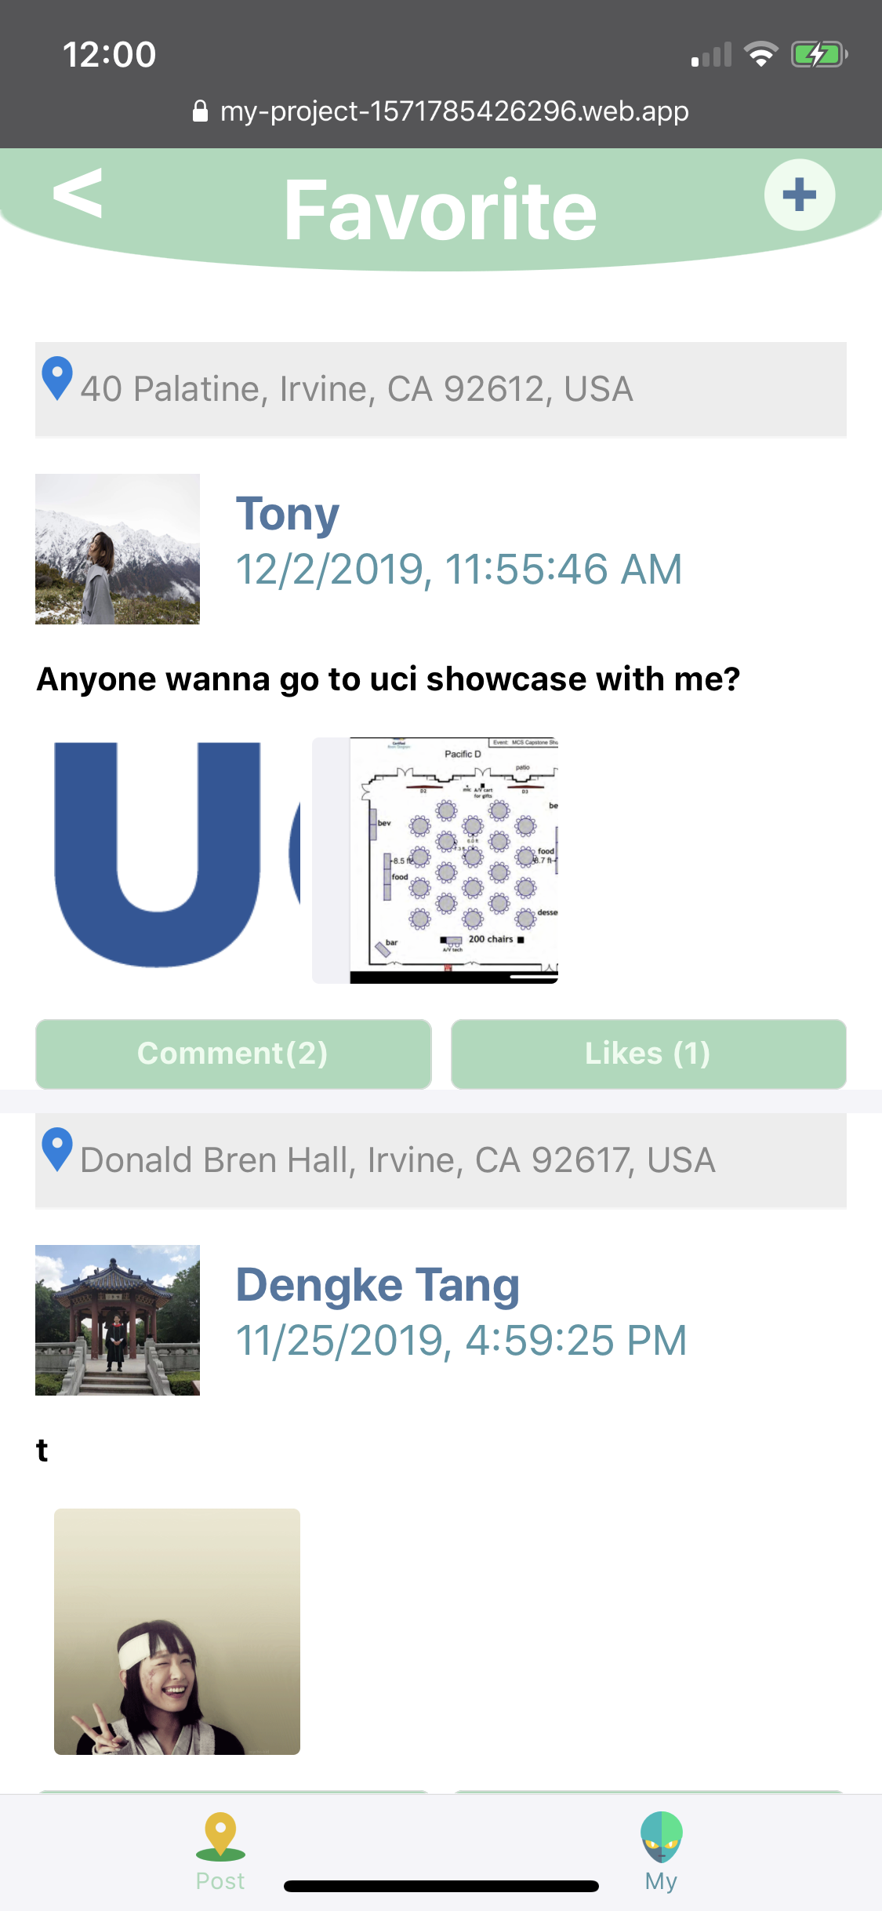
Likes
@Tony
You can view all you like in
Favorite Page

Slide 19

Business Model

Slide 20
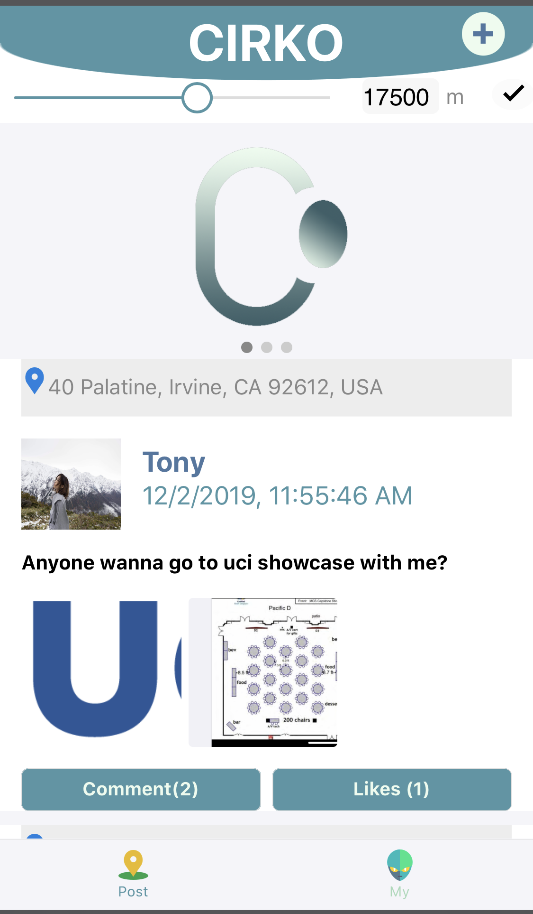
Ads
@Tony
We set advertisement rotator on the top of homepage, of which contents are filtered according to the users’ location.

Slide 21






Users
Advertiser
The intelligent recommendation helps users find somewhere to have fun/ dine out.
The intelligent recommendation pushes the ads to nearby users, promoting the consumption.
Users

Slide 22
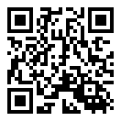
my-project-1571785426296.web.app/
Scan QR code/
input the link

